Slide 1

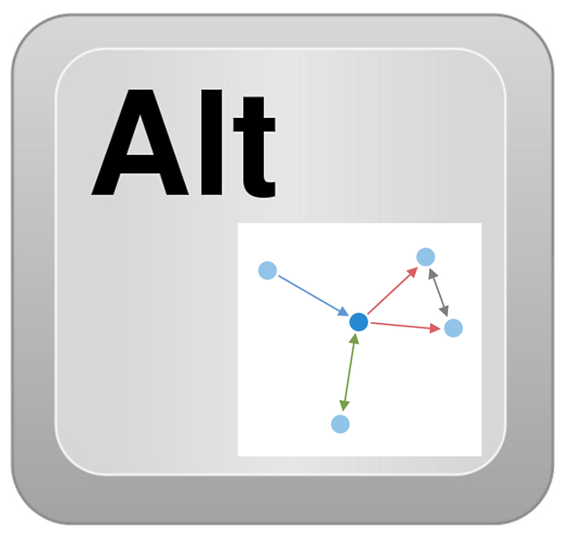
Azure Cosmos DB – AltGraph
Chris Joakim, Microsoft, Cosmos DB Global Black Belt (GBB)
https://www.linkedin.com/in/chris-joakim-4859b89
https://github.com/cjoakim/azure-cosmosdb-altgraph
https://www.youtube.com/watch?v=SGih_Kj_1yk

Slide 2
What is AltGraph?
AltGraph is a set of Alternative Graph Implementations built on:
A Set of Designs:
Using the Azure Cosmos DB NoSQL API
Fast In-memory processing vs DB and Disk Traversal
RDF-like “Triples” (v1) or the JGraphT library (v2)
Azure Redis Cache or Cosmos DB Integrated Cache
Two Reference Implementations – v1/NPM and v2/IMDb, using:
The Java programming language
Spring Boot and Spring Data frameworks
https://github.com/cjoakim/azure-cosmosdb-altgraph

Slide 3
Presentation Outline
Influences
Real-world Use Cases
Previous Cosmos DB Live TV Sessions
LinkedIn / LIquid,
Perception: How you See the Problem often determines your solution
Sample Database Diagrams
Types of Databases
Think Differently: Why another Graph Implementation?
Design
Demonstration of the Reference Application

Slide 4
Influences
Real-World Customer Use-Cases
Manufacturing Bill-of-Material (BOM)
Social Network Systems - People, Messages, Posts, Tags, etc.
Knowledge Graphs
Java and Spring and Spring Data
Previous Cosmos DB Live TV Sessions
Kushagra Thapar, Spring Data, 2022/02/03
Mark Heckler, Spring Boot, 2022/06/23
Spring Boot: Up and Running – O’Reilly Media Book
List of Episodes https://www.youtube.com/playlist?list=PLmamF3YkHLoKMzT3gP4oqHiJbjMaiiLEh
LinkedIn / LIquid
In-memory graph
https://engineering.linkedin.com/blog/2020/liquid-the-soul-of-a-new-graph-database-part-1

Slide 5
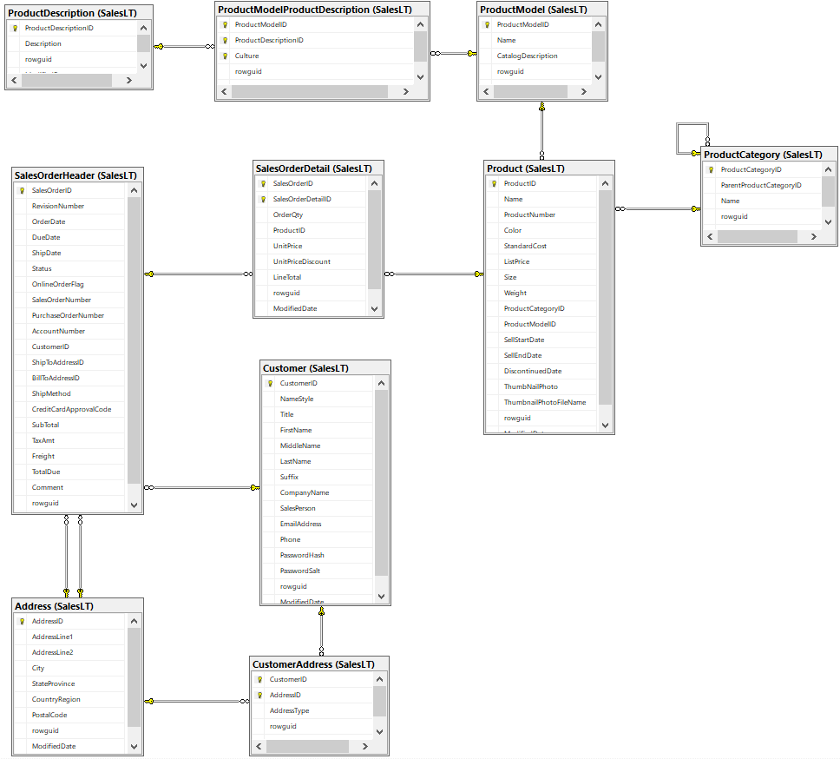
Perception: What solution would you use if the problem was drawn like this?

Slide 6
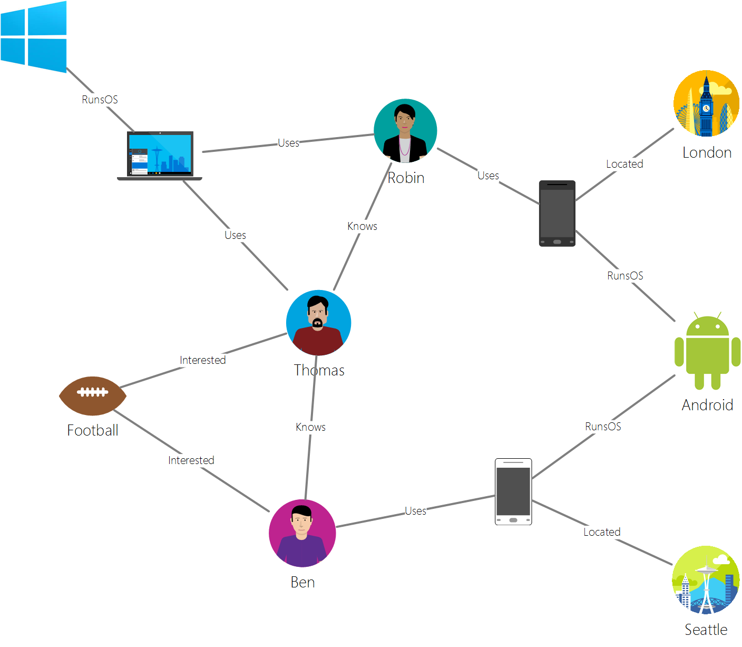
Perception: Or if the problem was drawn like this?
We see this a lot in the field.

Slide 7
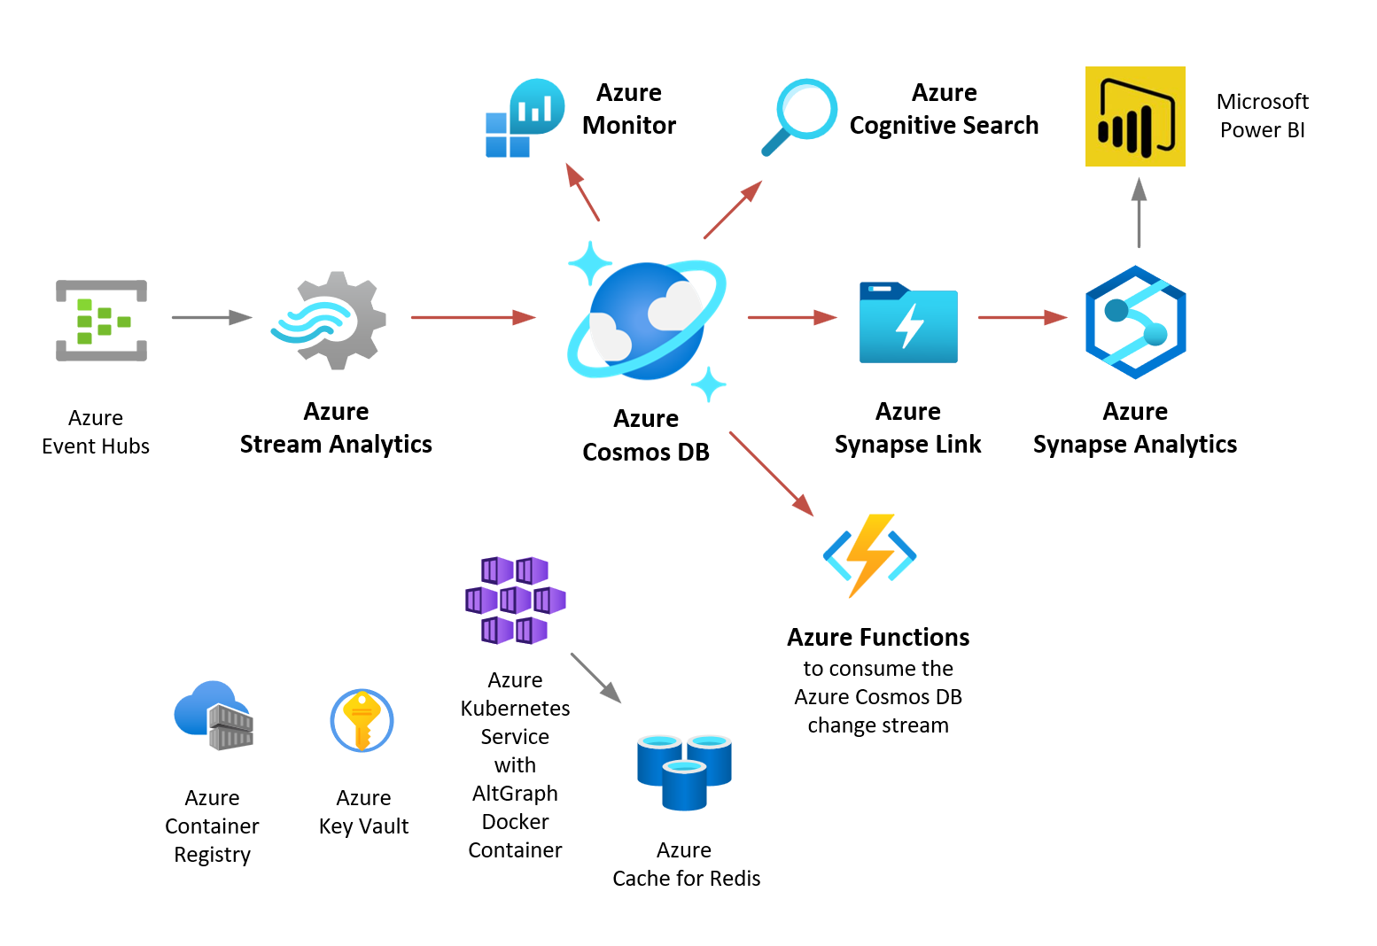
A Total Solution involves more than just the Database.
Database Integrations are important. The red lines show native integrations.
The Cosmos DB NoSQL API offers excellent integration with other Azure Paas Services.

Slide 8
Database Solutions
Types of Databases
Relational: Transactional use-cases
Graph: Graph-specific use-cases. RDF (triplestores) and LPG (vertices, edges)
NoSQL: including the Cosmos DB NoSQL API: General Purpose
Think Differently; Why another Graph Solution?
Fast execution speed, and lower Cosmos DB RU costs
Lower barrier to entry for new apps: simplicity, based on SQL
Structured Query Language. Zero-to-low learning curve vs Graph DB syntaxes
Reusable design
Faster time-to-market. Zero to POC in days. A Reference Implementation
Enables better integration with the rest of Azure

Slide 9
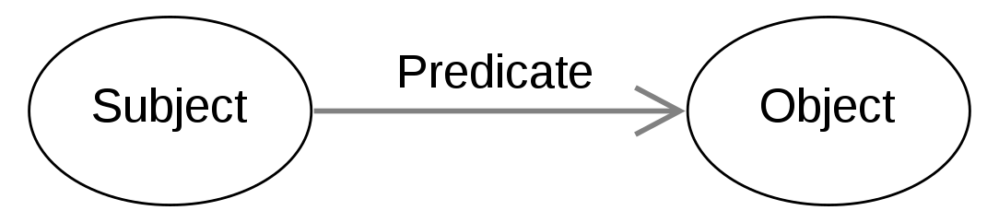
Design Foundations: The concept of RDF Triples and Triplestores
Examples:
Microsoft is_a Technology Company
Java is_a Programming Language
C is_a Programming Language
Cosmos DB is_a Database System
Cosmos DB is_a NoSQL Database System
Cosmos DB has_a_sdk_for Java
Cosmos DB has_a_sdk_for C#
Chris works_at Microsoft
Chris has_role GBB
The triples are quite granular, typical solution has many many of these

Slide 10
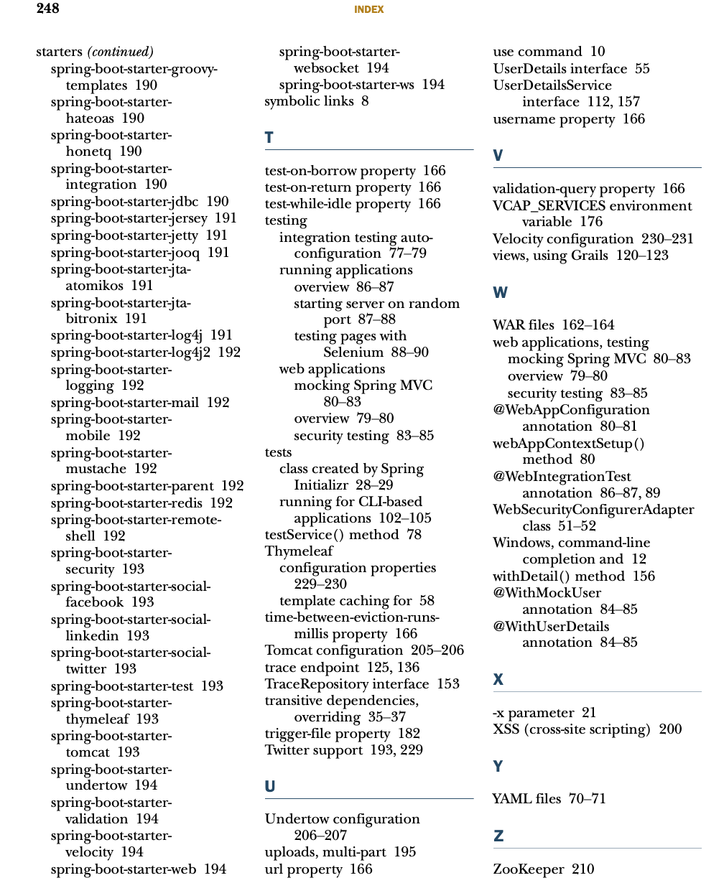
Design Foundations: The concept of an Index (as in Book)
Indexes enable you to quickly
find what you’re looking for.
It’s quite small relative to the size of the Book it indexes.

Slide 11
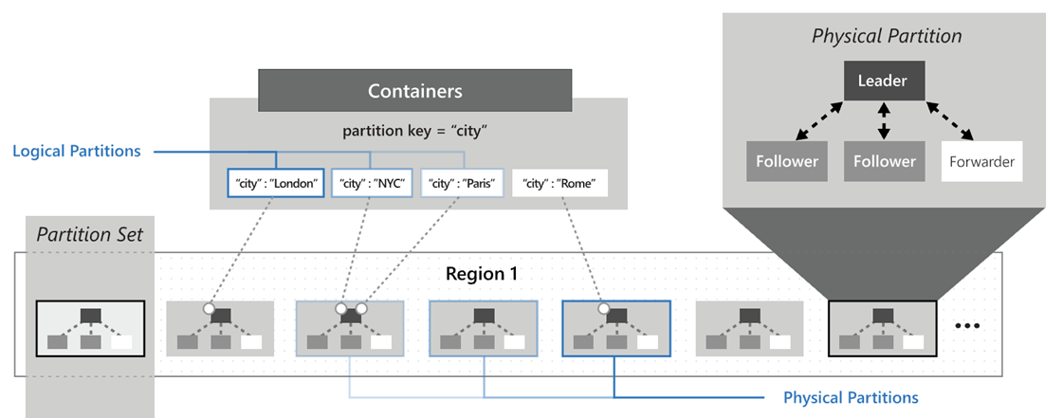
Design Foundations: Cosmos DB Partitioning
Reads within the same logical and physical partition are faster.
The Triples and Seed Data (see following pages) can reside in the same logical partition.

Slide 12
Design Foundations: Performance Optimizations
Cosmos DB Indexing and Composite Indexes
Index individual attributes, and as well as sets of attributes (i.e. – composite indexes)
to match your queries
Cosmos DB "Point Reads"
Read by Document ID and Partition Key for fastest speed and lowest cost
In-Memory Processing is much faster than DB Processing
Traversing an in-memory data structure is 1000s of times faster than reading a DB or disk
Caching
Eliminate costly and redundant reads to the database
Azure Redis Cache
https://azure.microsoft.com/en-us/services/cache/
Cosmos DB Integrated Cache (currently in preview mode)
https://docs.microsoft.com/en-us/azure/cosmos-db/integrated-cache

Slide 13
Design Foundations: Spring Boot, Spring Data, Project Lombok
Spring Boot
Dependency Injection, “Convention over Configuration”
Similar to Ruby on Rails – lots of magick happens if you follow the conventions
Thus, high Developer productivity
https://spring.io/projects/spring-boot
Spring Data
Nice abstraction and simplification for database access. Repositories, Templates
https://spring.io/projects/spring-data
Spring Data for Cosmos DB SDK
https://docs.microsoft.com/en-us/azure/developer/java/spring-framework/how-to-guides-spring-data-cosmosdb
Project Lombok
Eliminates verbose and low-value boilerplate code. Getters, setters, constructors, etc.
Generates bytecode at compile time. Nice IDE support, too
https://projectlombok.org

Slide 14
Design Foundations – v2: Java Graph Libraries, intern() Strings
JGraphT
A mature widely-used in-memory graph Java library
Implements many graph algorithms so you don’t have to
Page Rank
Katz Centrality
Dijkstra Shortest Path
Others
https://jgrapht.org/
Java String intern()
Use a single value in the JVM for a frequently occurring value
For example, use just one instance of “nm0000102” (Kevin Bacon) instead of dozens/hundreds. This conserves JVM memory, thus enabling large in-memory graphs.
Similar to a Ruby programming language Symbol. ‘kevin_bacon’ vs :kevin_bacon

Slide 15
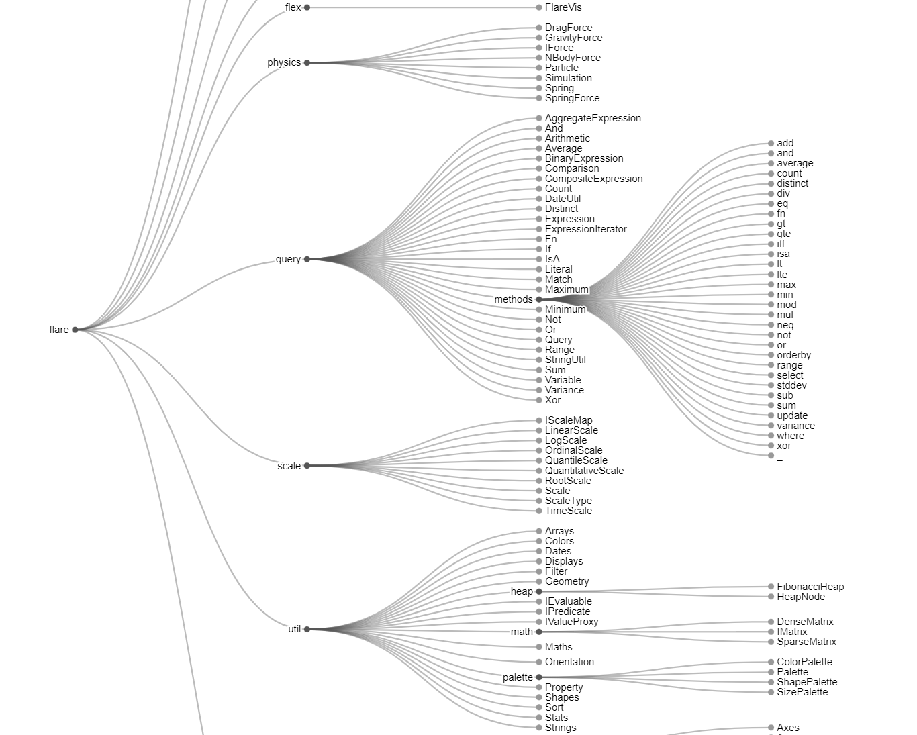
Design Foundations: D3.js
D3.js JavaScript library for in-browser data visualizations
Implements many out-of-the-box visualizations. Open-source. https://d3js.org
Alternatively, Bring-Your-Own-Visualization-Library (BYOViz)
https://learn.microsoft.com/en-us/azure/cosmos-db/graph/graph-visualization-partners

Slide 16
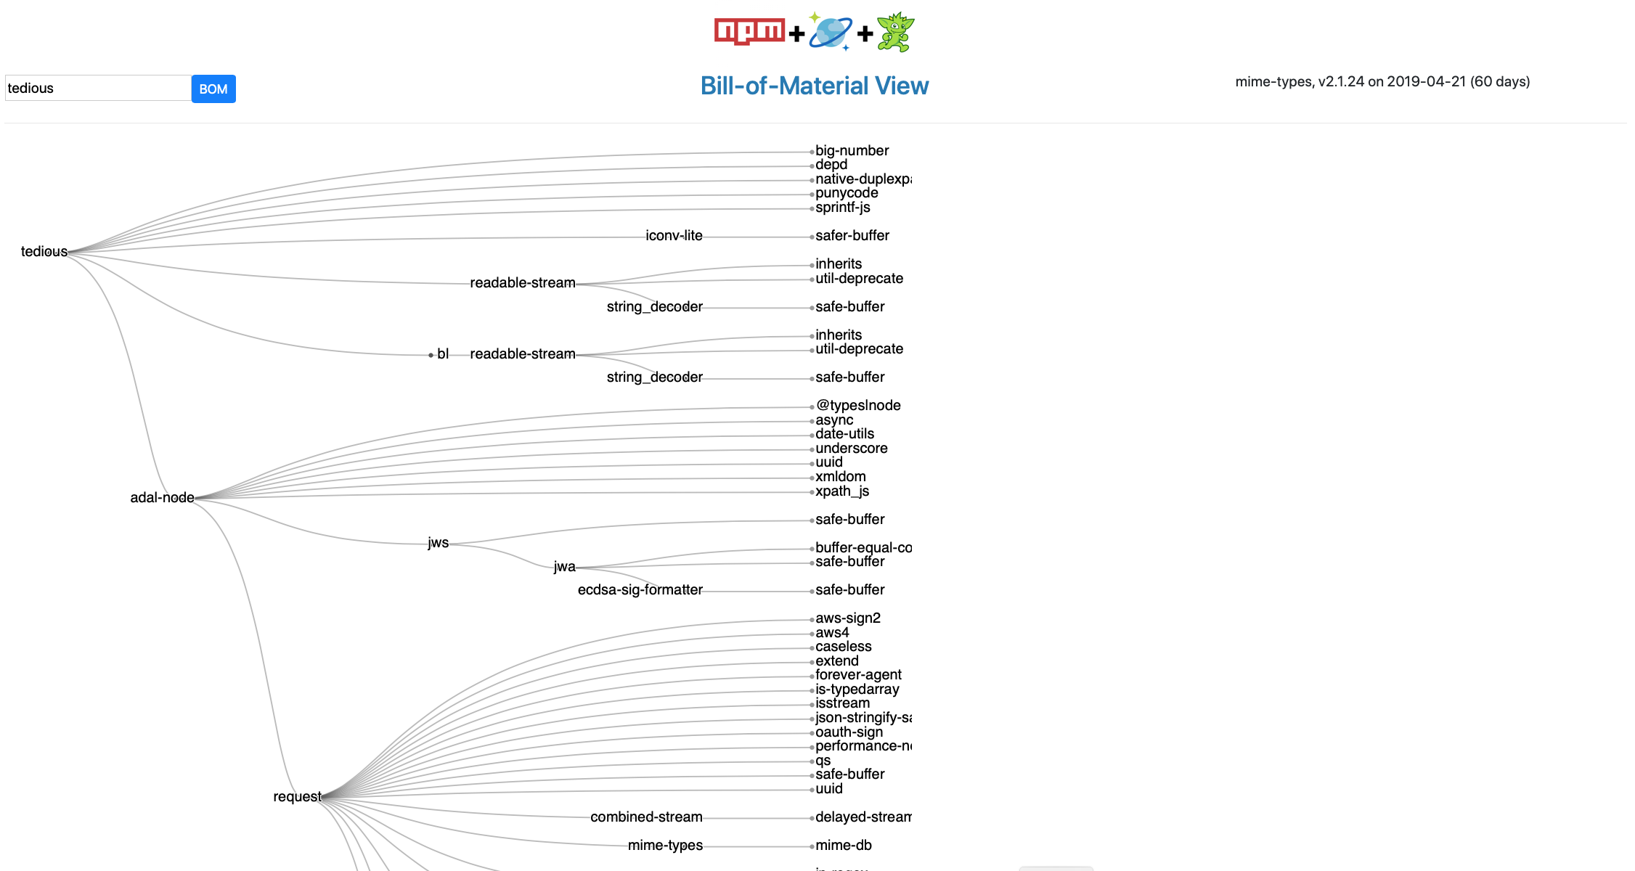
Design Foundations: Previous Implementation
Cosmos DB Gremlin API Implementation of a Node.js NPM “Bill-of-Material” Graph
AltGraph v1 uses the same NPM data as this previous implementation
https://github.com/Azure-Samples/azure-cosmos-db-graph-npm-bom-sample

Slide 17
Implementation – v1/NPM: Cosmos DB NoSQL API
Use a Single Container: npm_graph
Partition key is /pk
Each document has a doctype attribute to distinguish the various entities
Reference implementation has a tenant Id attribute for multi-tenant use-cases
Reference implementation has a lob attribute for multiple lines-of-business in a tenant
Document types for this NPM graph are: triple, library, author, maintainer
Enabling Synapse Link is optional, depending on your requirements
This is one of the excellent integrations that Cosmos DB offers
https://docs.microsoft.com/en-us/azure/cosmos-db/synapse-link
https://github.com/cjoakim/azure-cosmosdb-synapse-link
Heirarchical Partition Keys (currently in preview mode) may also be used
https://docs.microsoft.com/en-us/azure/cosmos-db/hierarchical-partition-keys
Provision the Request Units (RU) as necessary – Serverless, Manual, or Autoscale
https://docs.microsoft.com/en-us/azure/cosmos-db/set-throughput
https://docs.microsoft.com/en-us/azure/cosmos-db/serverless

Slide 18
Implementation – v2/IMDb: Cosmos DB NoSQL API
Use Two Containers: imdb_graph and imdb_seed
Partition key is /pk for each container
Each document has a doctype attribute to distinguish the various entities
imdb_graph container contains the people and movie documents
imdb_seed container contains the “seed data” to reload the graph into memory
The seed data is used instead of the “RDF Triples” in the v1 implementation
The movie data, for example, all resides in the same logical partition
Reference data contains over 1-million vertices and 3.9 million edges
Load time is approximately 50-seconds from home network
Larger in-memory graphs are possible
The in-memory graph is mutable for realtime use-cases
Navigation of the graph is mostly done with the built-in functionality in JGraphT
Load the data into memory once, then apply surgical changes to the mutable graph
Graph Traversal is fast and consumes zero Cosmos DB RUs

Slide 19
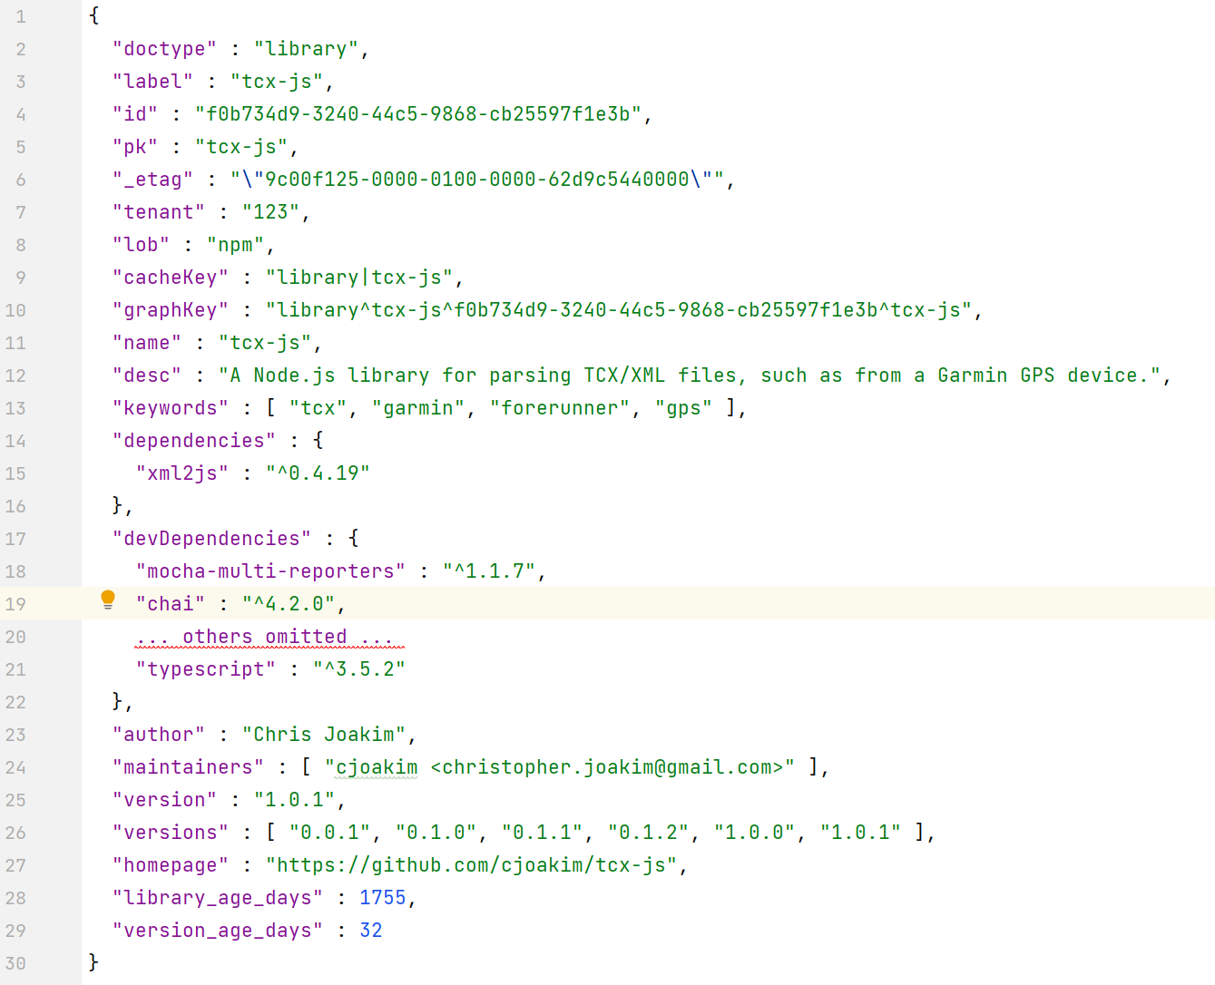
Implementation – v1/NPM: Sample Library Document
This is a JSON document which describes a Node.js NPM Library. Libraries are the “raw material” for the graph.
The dependencies object (at line 14) is the data that we’ll use to build a graph. This sample document is intentionally small. This library has only one dependency: xml2js
Note the author and maintainers attributes, as well.
The graph will include these.

Slide 20
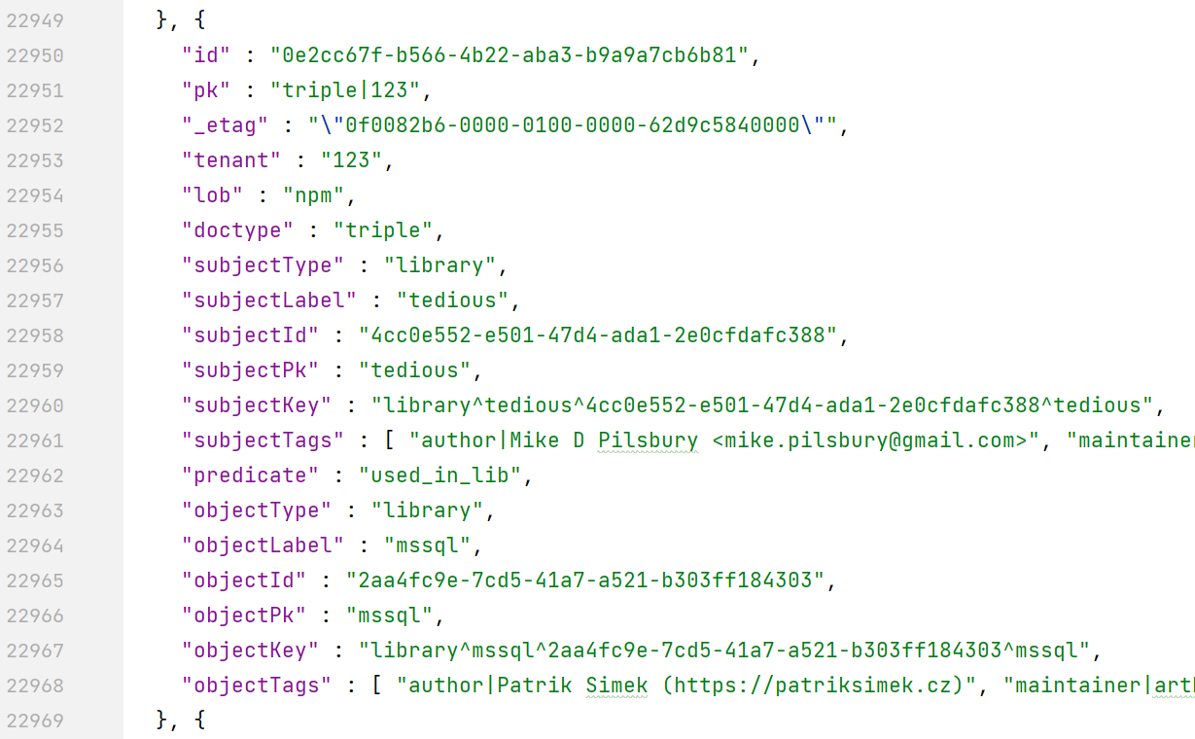
Implementation – v1/NPM: Sample Array of Triples
Triple documents have a Subject, Predicate, and Object just like RDF triples. Up to 20 million of these 1K docs can reside in the same logicical partition (20GB limit).
This graph contains 6382 triples. They are small in size (1kb) and many can be read into the JVM for in-memory processing and traversal. Pagination-based processing is also possible.
They point to the adjacent “Vertices” via the Id/Pk attributes for point-reads.
The tags enable optimized searching of important Vertex attributes.

Slide 21
Implementation – v1/NPM: Primary Java Classes
Cache.java - implements caching logic, to local disk or Azure Redis Cache
D3CsvBuilder.java - Creates node and edge CSV files for D3.js
Graph.java - An in-memory graph created from a TripleQueryStruct
GraphBuilder.java - Builds a graph by iterating an in-memory TripleQueryStruct
TripleQueryStruct.java - Represents an Array of the Triples for your graph. It is the “Index”.
Library.java - An NPM library document
Triple.java - One Triple document
LibraryRepository.java - Spring Data Repository for Libraries
TripleRepository.java - Spring Data Repository for Libraries
TripleRepositoryExtensions.java - Extensions of the Repository for more complex SQL
TripleRepositoryExtensionsImpl.java
GraphController.java - The primary Controller, handles interaction with the UI

Slide 22
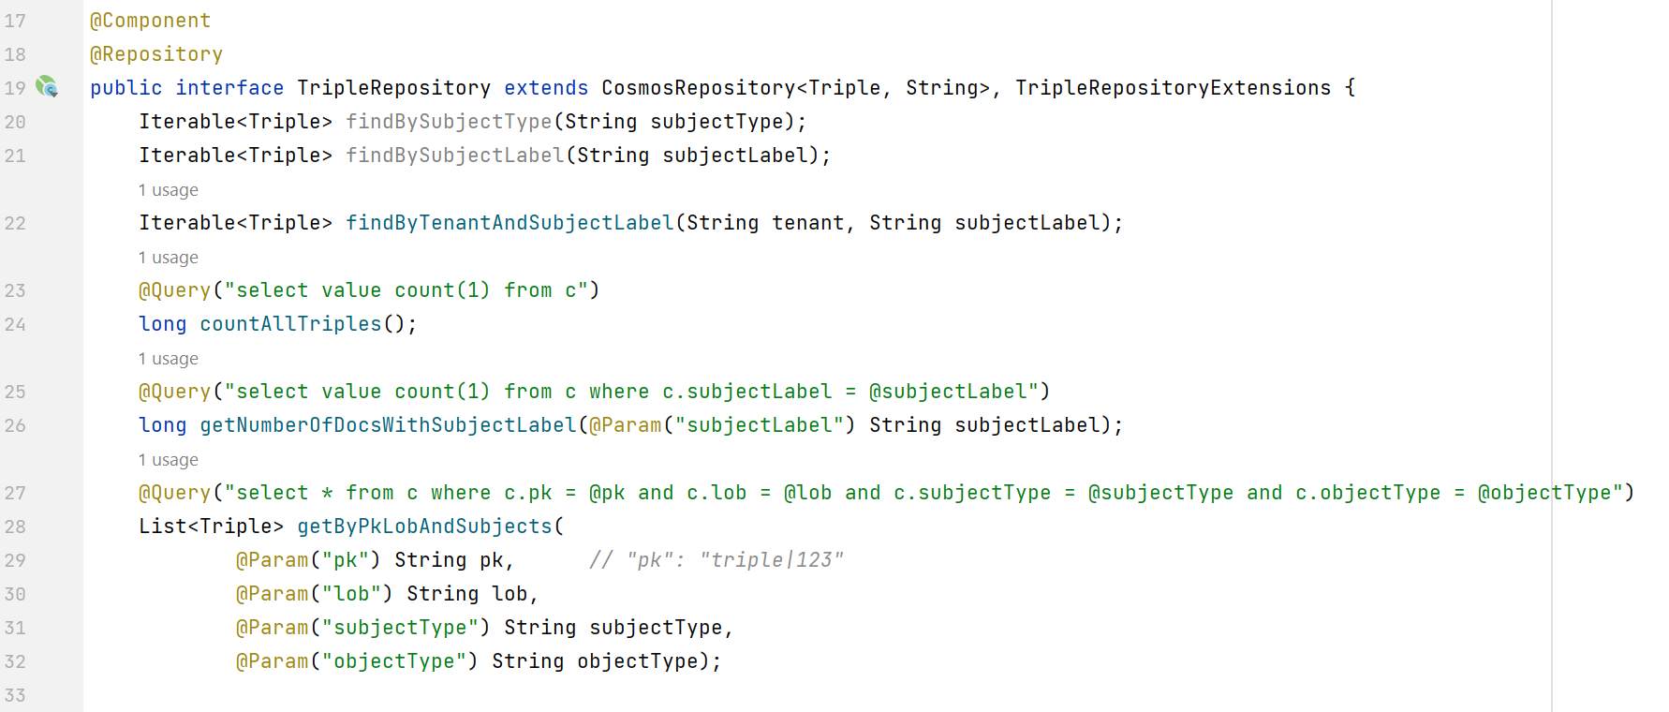
Implementation – v1/NPM: The Spring Data TripleRepository
TripleQueryStruct
Method getByPkLobAndSubjects is used to query the Triples and load them into memory as a TripleQueryStruct that can then be cached. It is the “Index” to your graph.

Slide 23
Implementation – v1/NPM: Building the Graph and Creating D3.js CSV
Ok, great, we have a TripleQueryStruct in memory, now what?
Optionally Cache it for the next Web Request
Class Cache
Build The Graph in Memory
Class GraphBuilder
Iterates, in memory, the many Triples in the TripleQueryStruct to build the Graph object
Alternatively, for huge graphs, paginate the Triples and build the graph with each page
Build the two CSV files for D3.js UI visualizations
Class D3CsvBuilder
Can we please see the demo now?

Slide 24
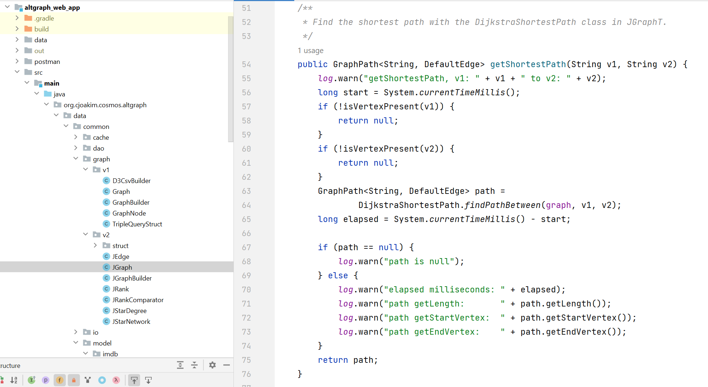
Implementation – v2/IMDb: Primary Java Classes
See the classes in package org.cjoakim.cosmos.altgraph.data.common.graph.v2.
Example shows the use of the JGraphT DijkstraShortestPath.findPathBetween method on line 64

Slide 25
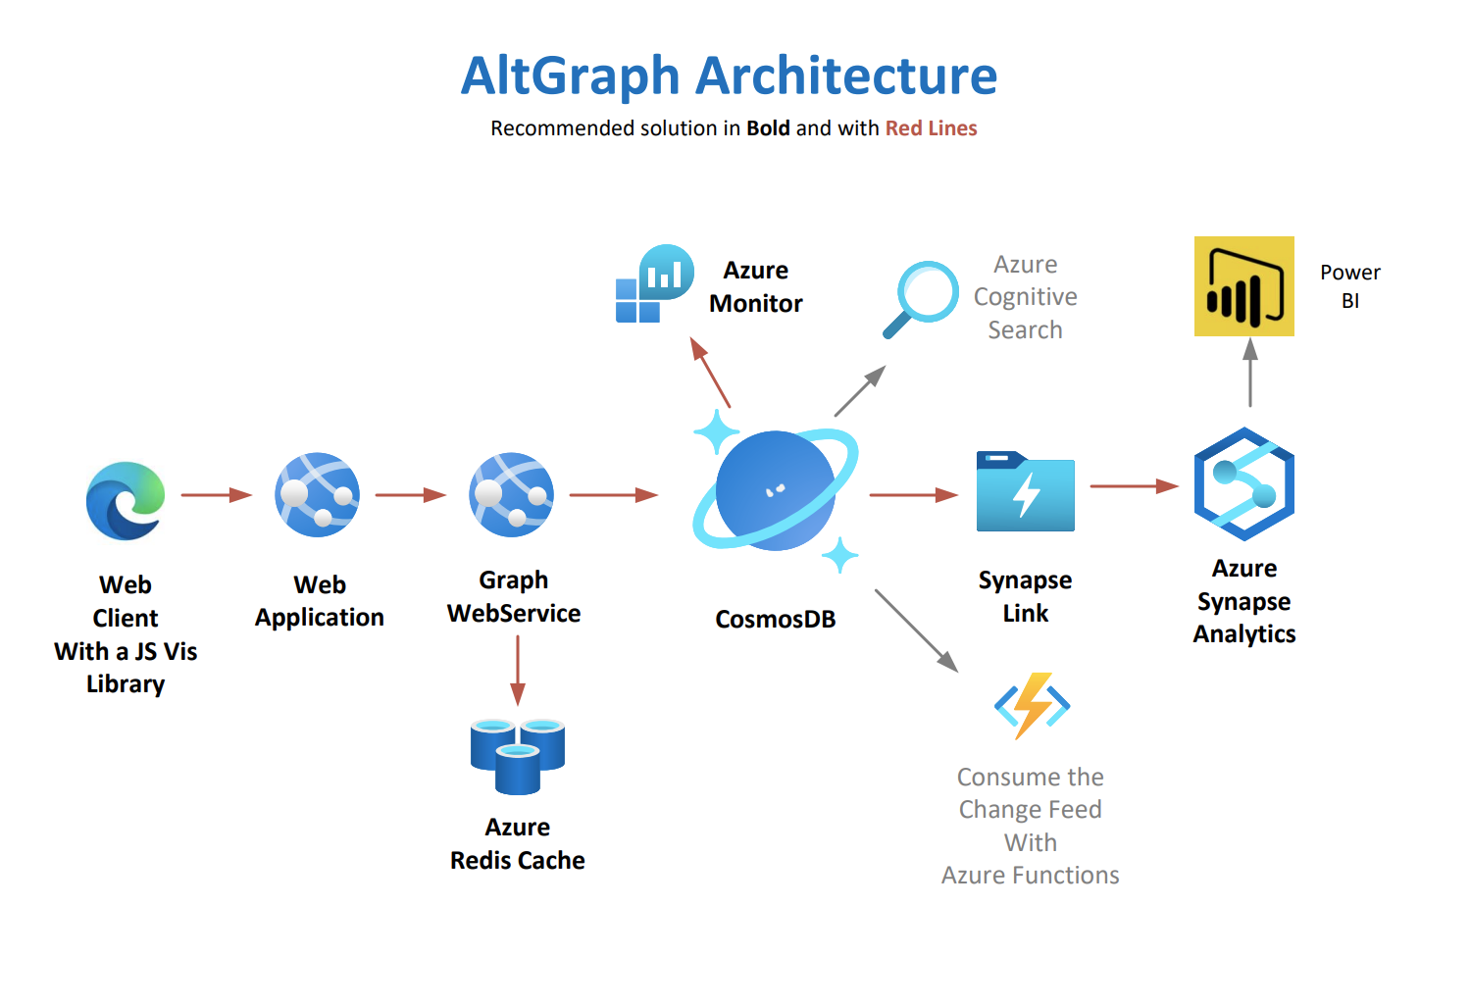
x
For demonstration purposes, the Web Application and Graph Web Service logic can run in just one Azure Container Instance.
Optionally use the Cosmos DB Integrated Cache.

Slide 26

Demonstration – v1/NPM: The Search Form
Enter a Library name, and integer graph “depth”.
Optional Cache Opts - “L” for Library caching, “T” for Triple caching.
The Elapsed ms field will be populated when the graph is displayed.
The Author checkbox will toggle between a Library and Author graph.

Slide 27
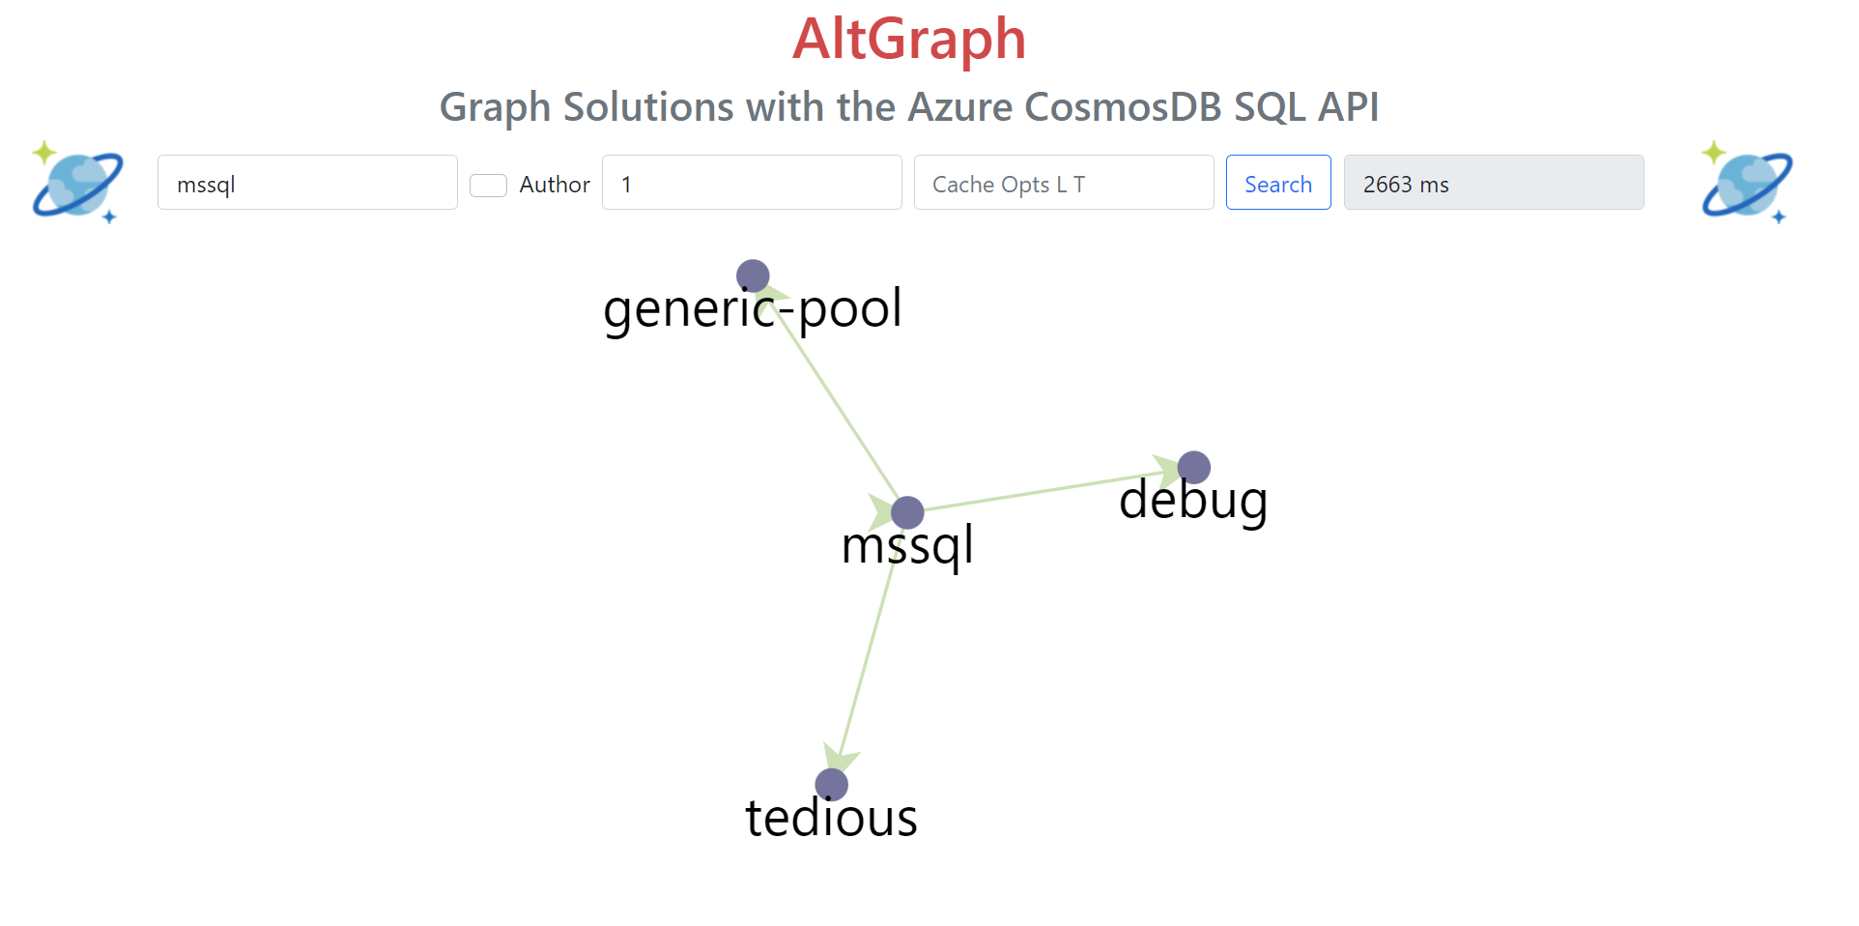
Demonstration – v1/NPM: Graph with a Depth of 1
Graph with a depth of 1 and no caching.
Single click a node for Library info. Double-click to show the graph for that node.

Slide 28
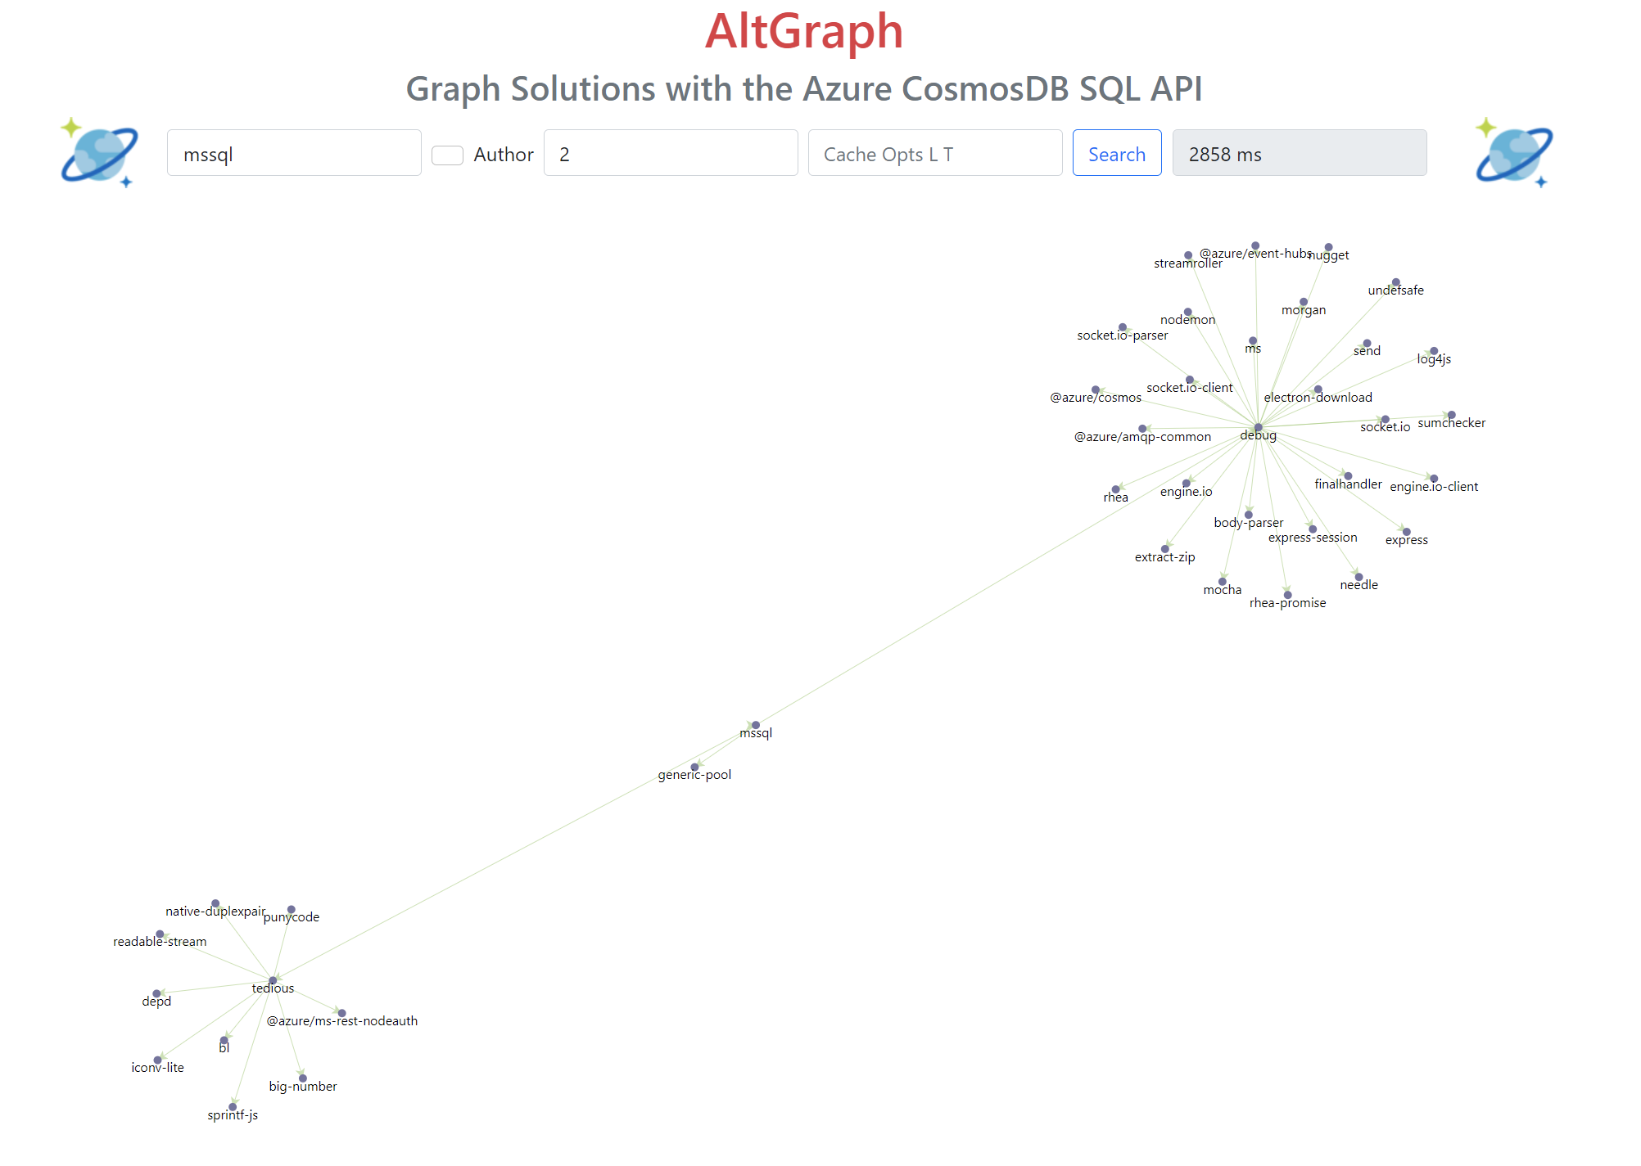
Demonstration – v1/NPM: Graph with a Depth of 2
Graph with a depth of 2 and no caching. D3.js positions the nodes.

Slide 29
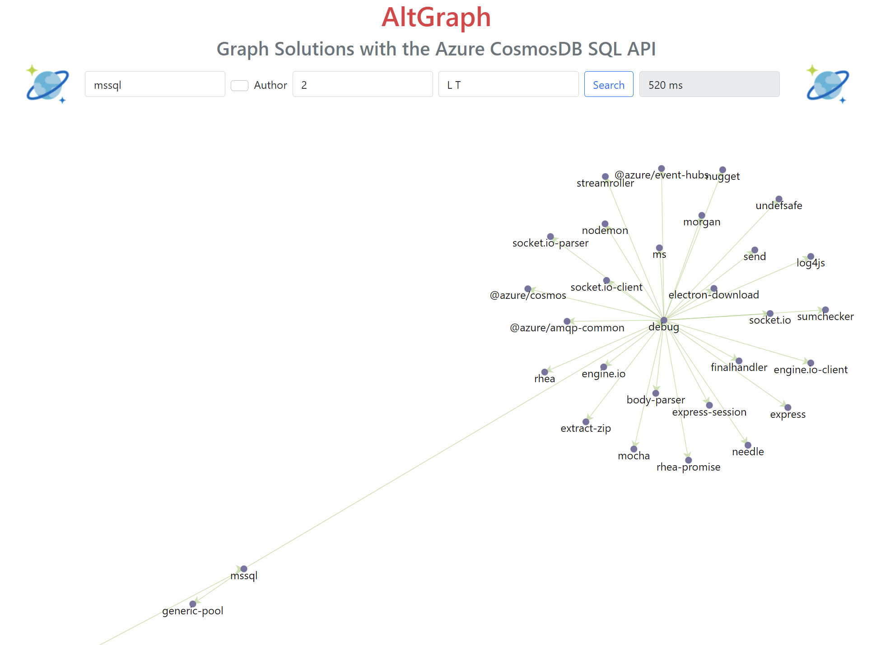
Demonstration – v1/NPM: Graph with a Depth of 2, with Caching
Graph with a depth of 2 and caching. Notice the speed improvement.
This example used Azure Redis Cache from my (slow) home WiFi network.

Slide 30
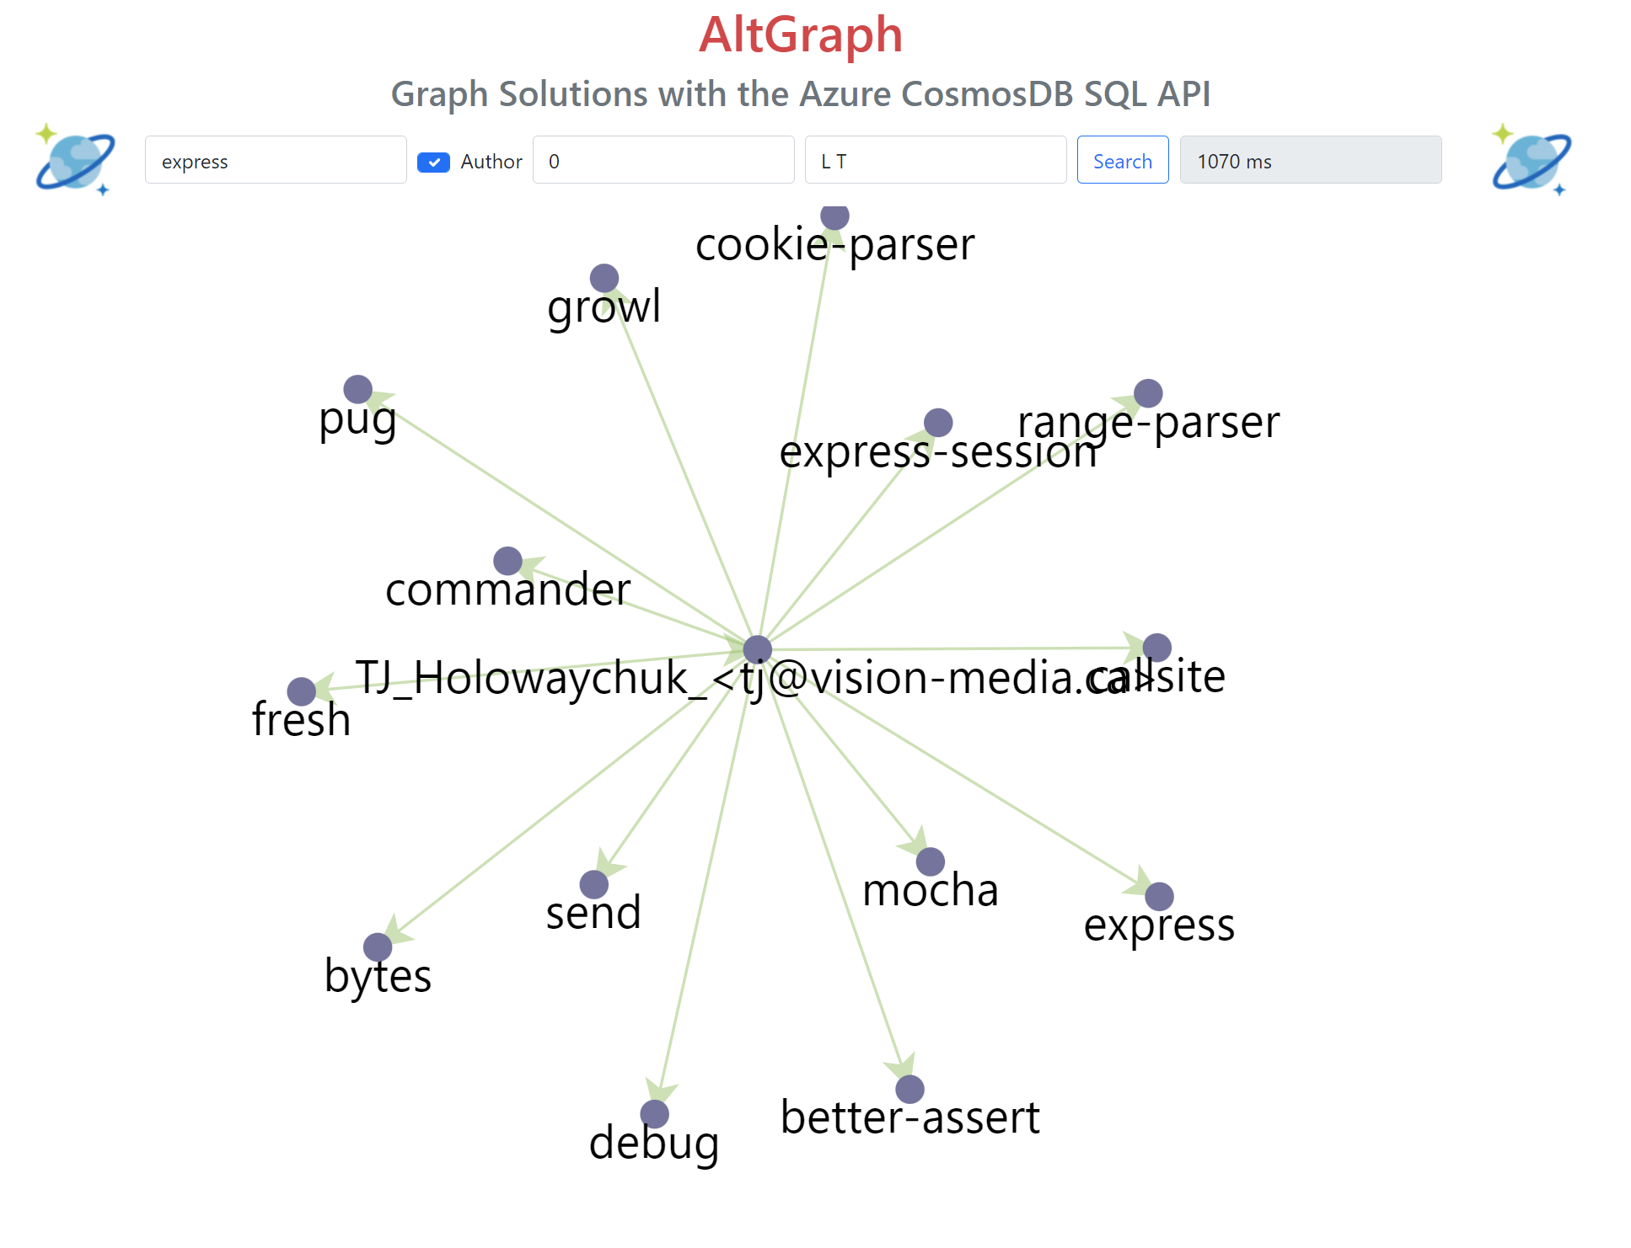
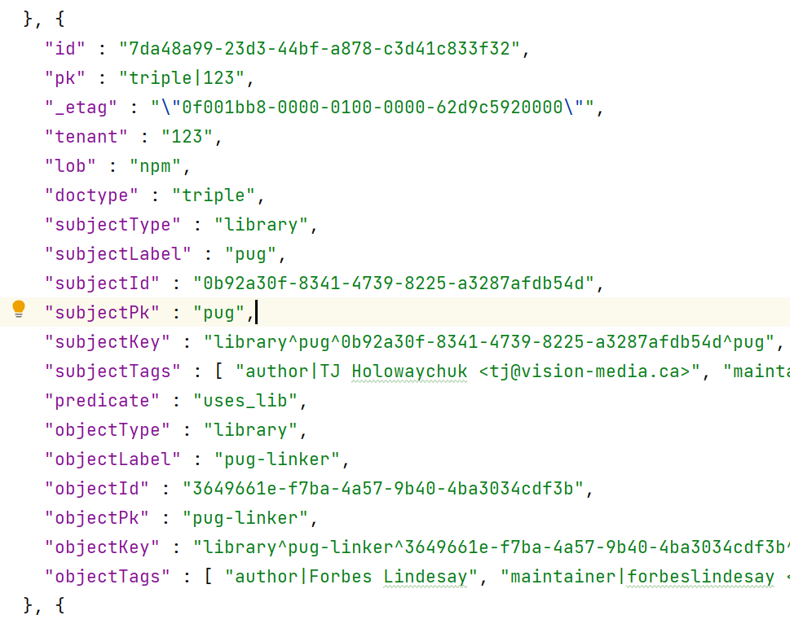
Demonstration – v1/NPM: Author-to-Library Graph using the Triple tag values
Graph, from tags, showing the Libraries authored by TJ Holowaychuk

Slide 31
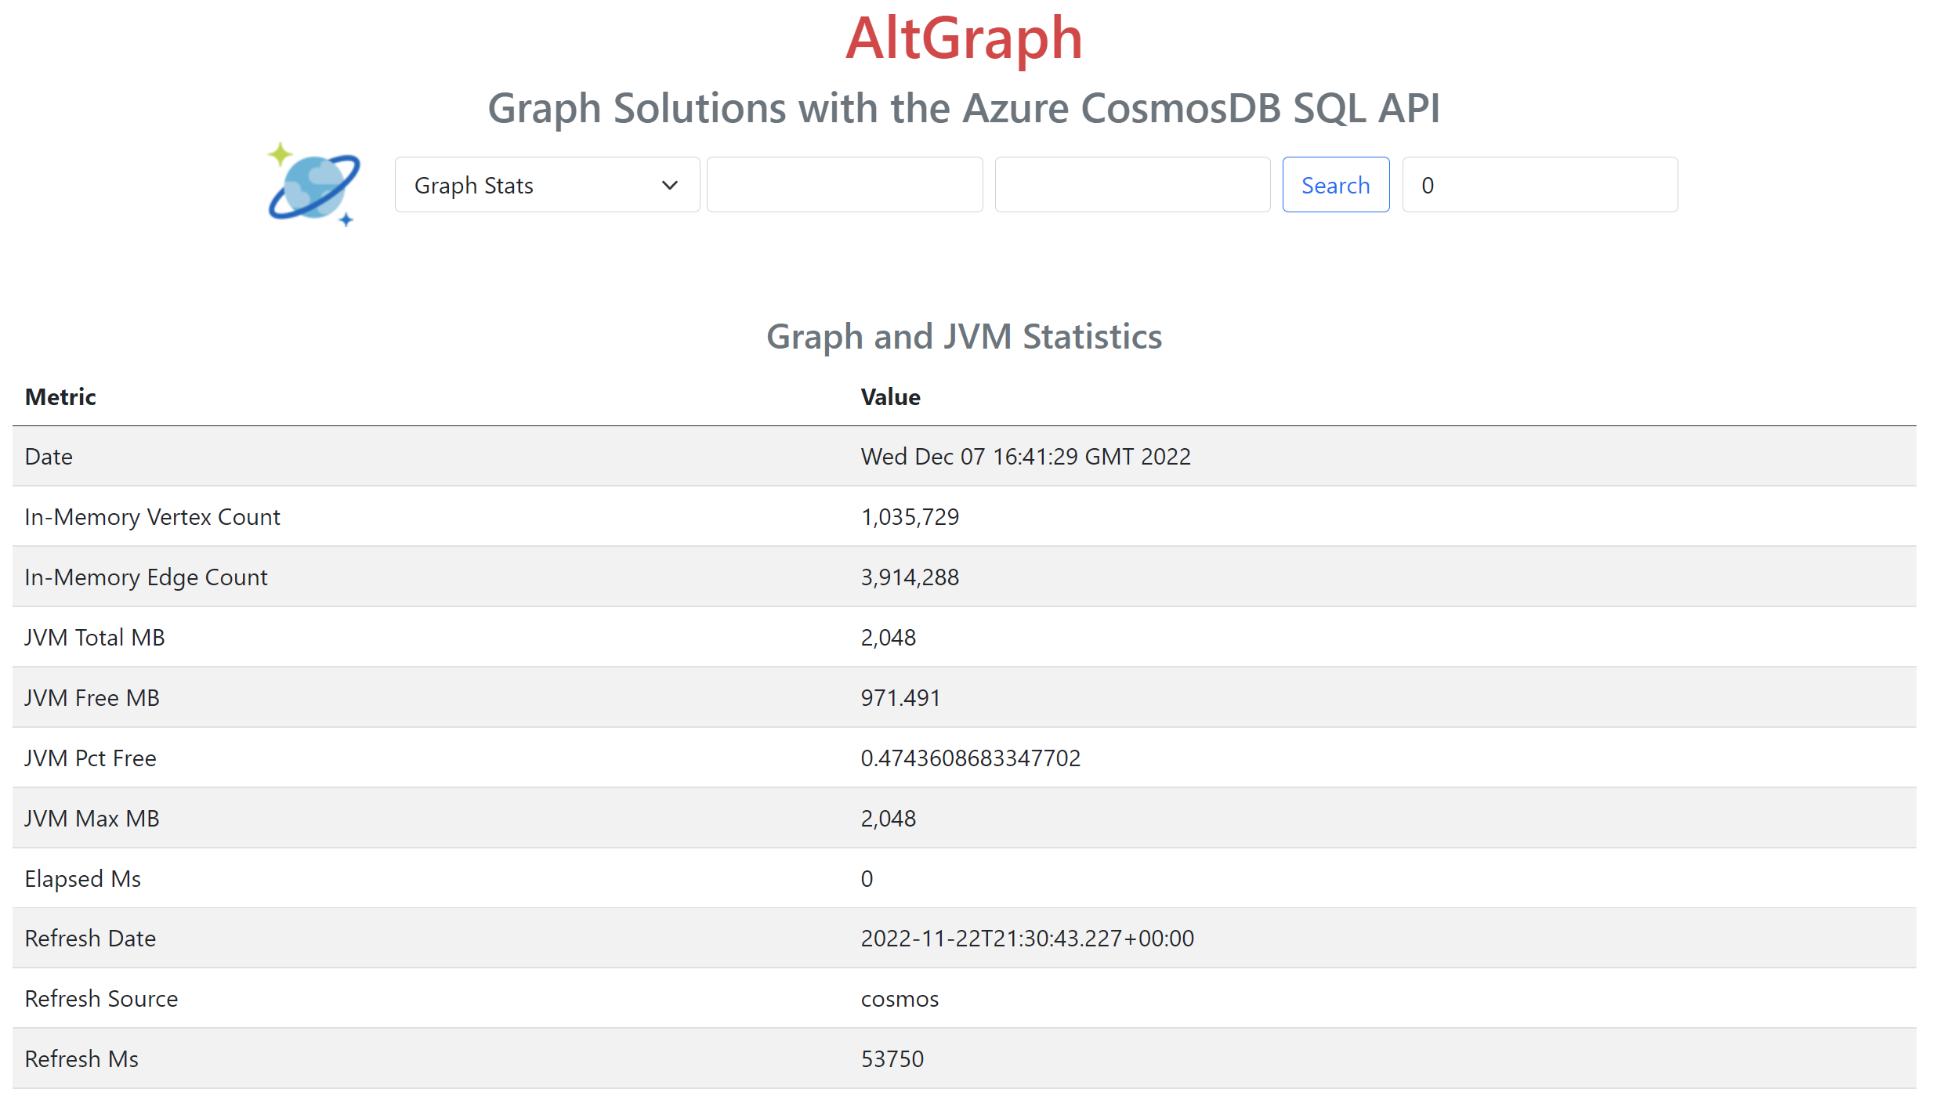
Demonstration – v2/IMDB: Graph and JVM Statistics
Query the size and JVM memory-consumption of the graph. This query typically takes 0 to 1 ms.
Note that this JVM graph was loaded on 11/22 and was still in-memory on 12/7.

Slide 32
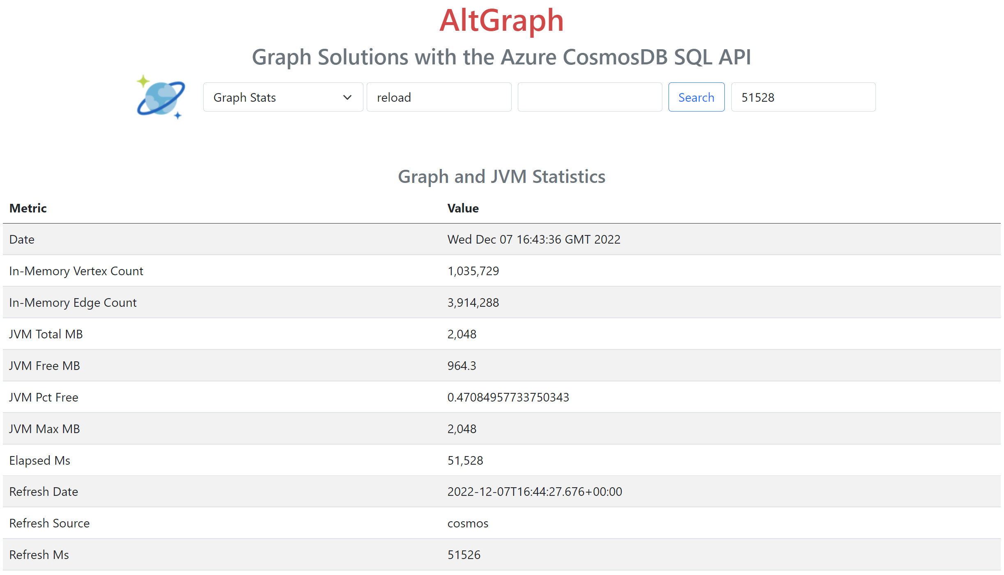
Demonstration – v2/IMDB: Graph and JVM Statistics
Trigger a reload of the in-memory graph from the Cosmos DB imdb_seed container.
The JVM can be running for days/weeks or longer. Note the 1m Vertices and 3.9m edges.

Slide 33
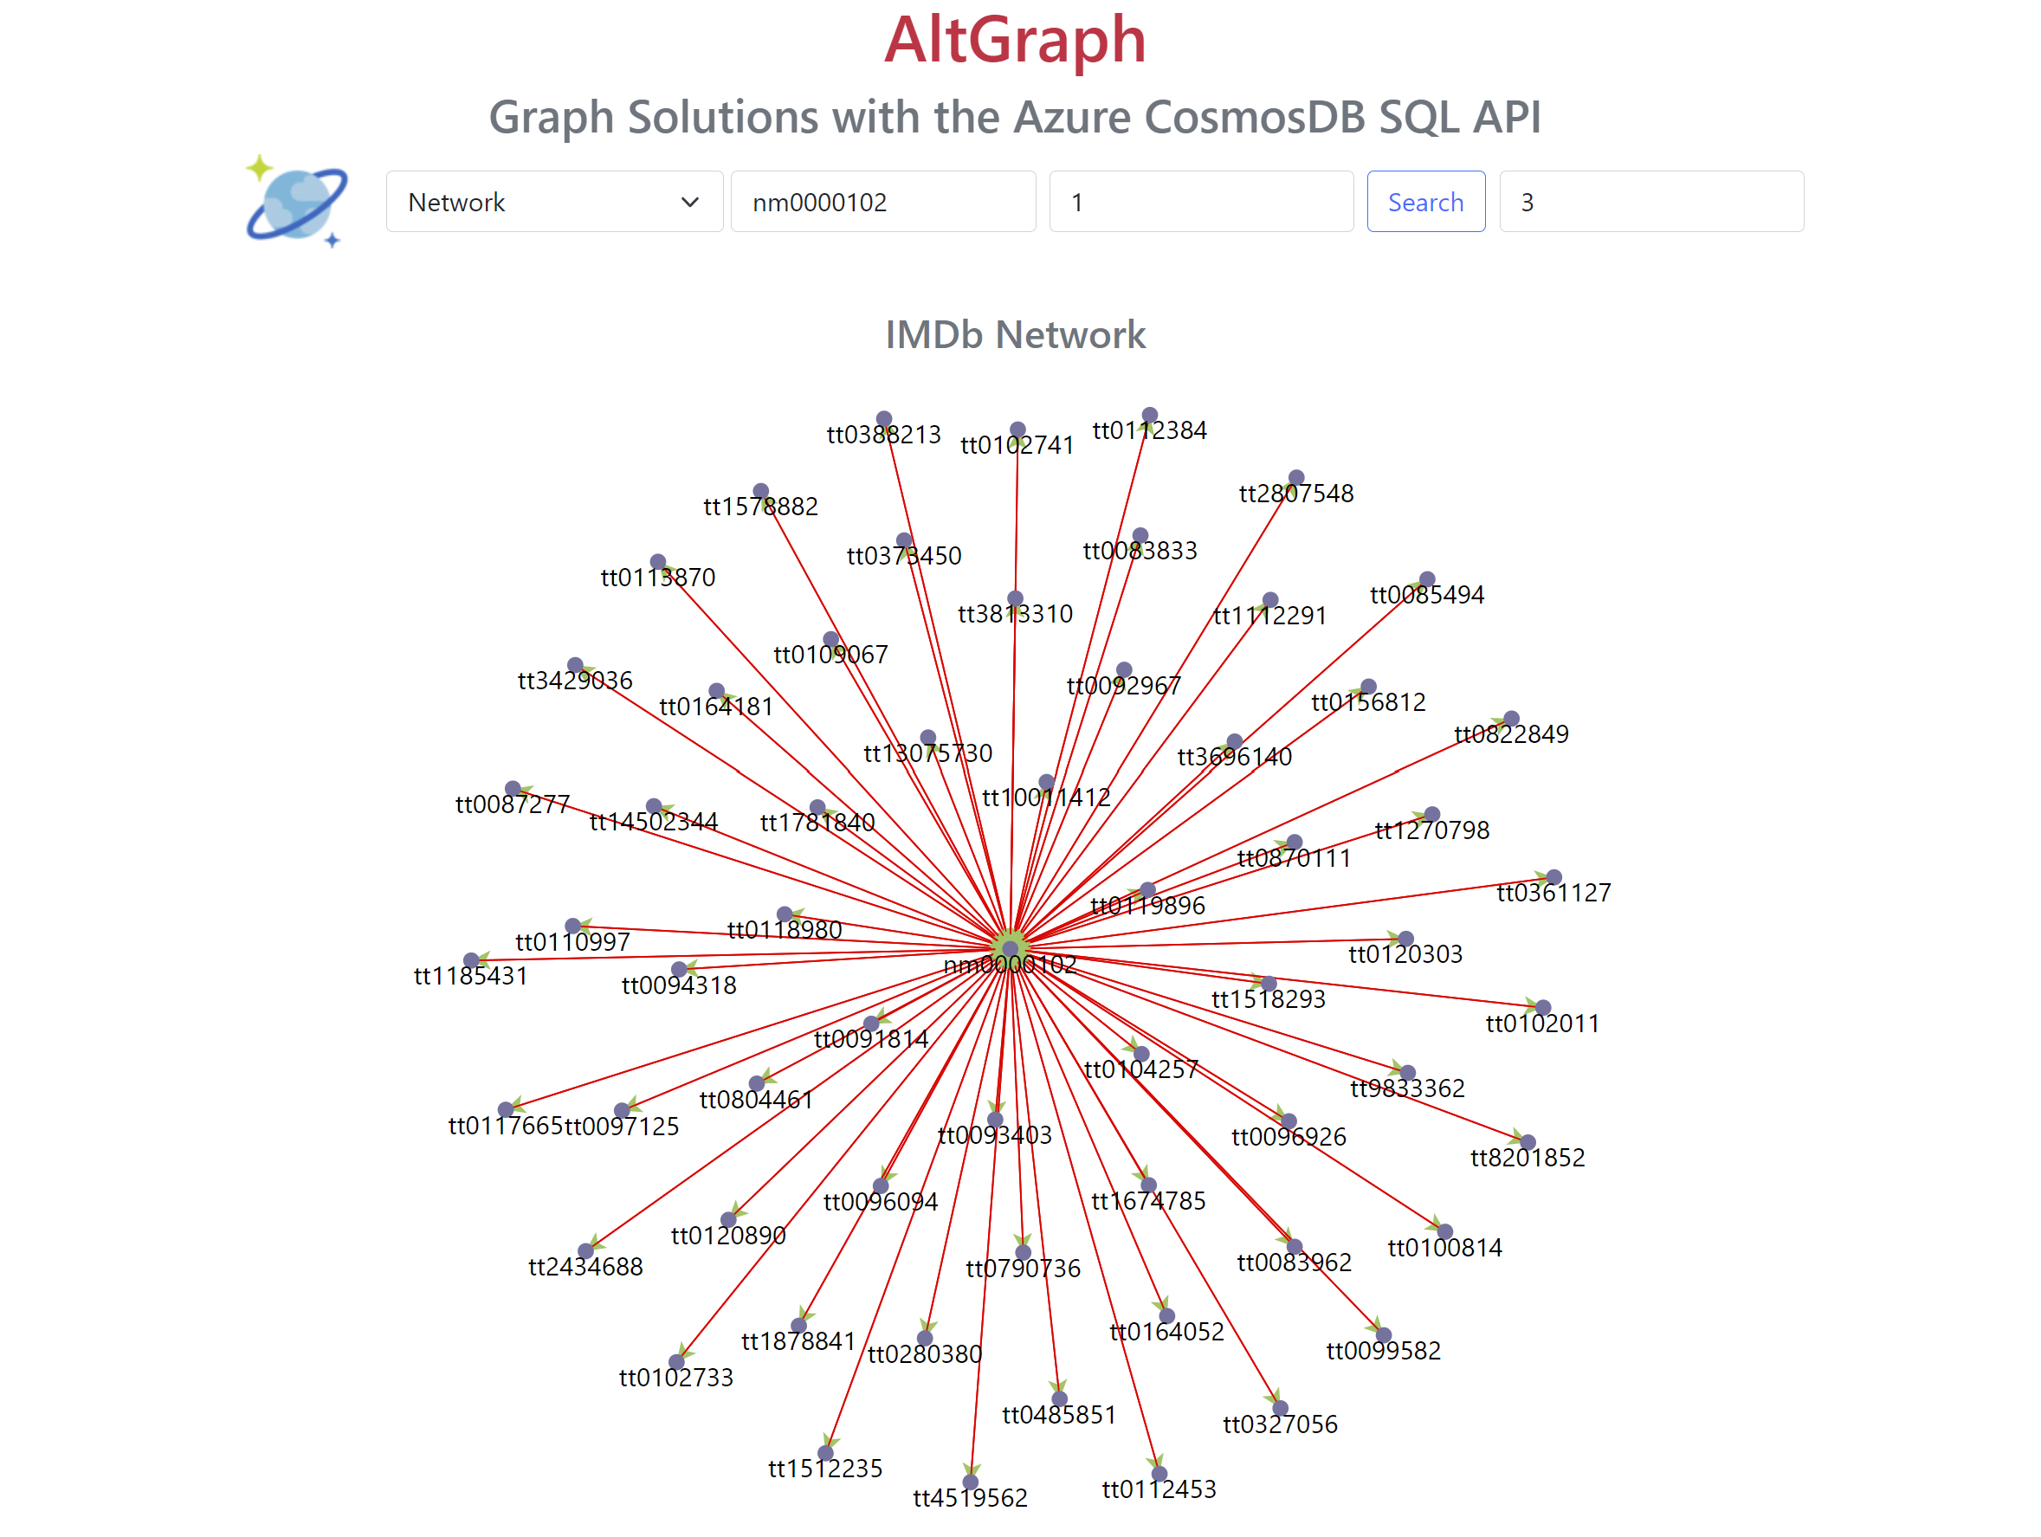
Demonstration – v2/IMDB: Network Graph, “One Degree of Kevin Bacon”
Traverses the adjacent vertices in 3 milliseconds, consumes zero Cosmos DB RUs.

Slide 34
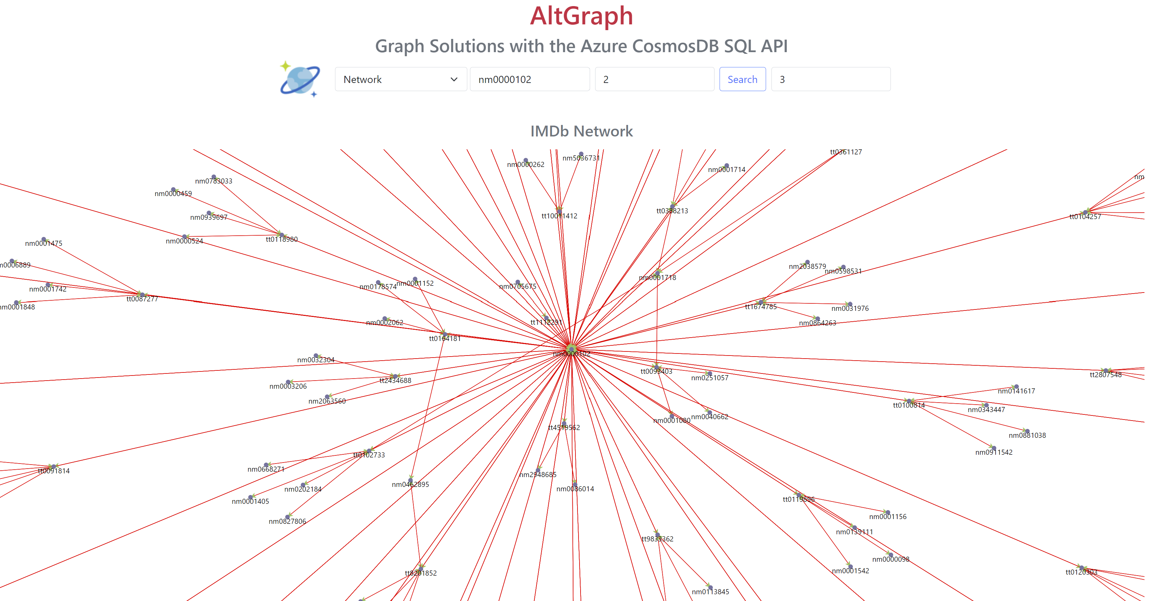
Demonstration – v2/IMDB: Network Graph, “Two Degrees of Kevin Bacon”

Slide 35
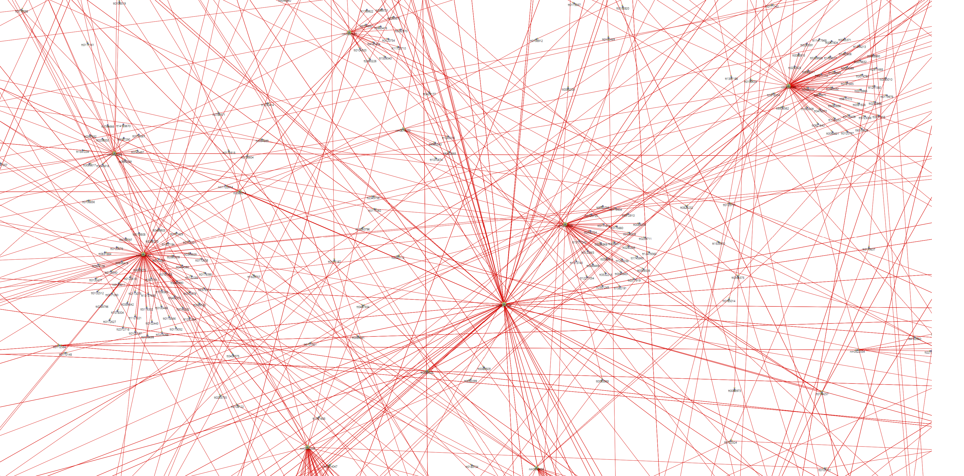
Demonstration – v2/IMDB: Network Graph, “Three Degrees of Kevin Bacon”
This is a very connected social network! But how do I find the path from Kevin Bacon to Charlotte Rampling?….

Slide 36
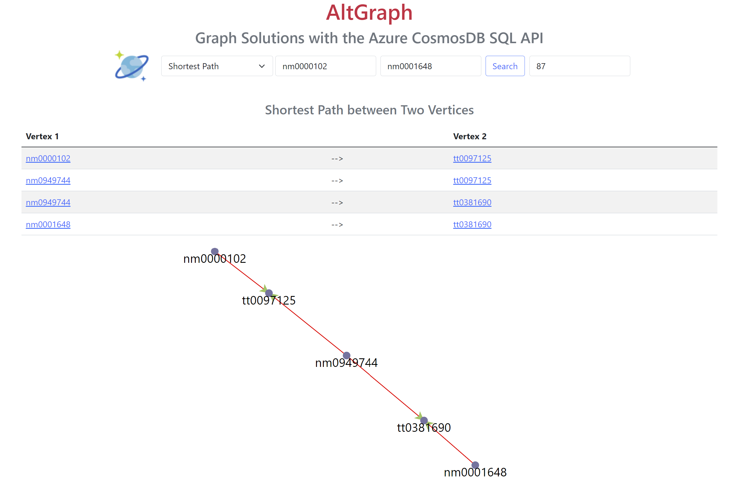
Demonstration – v2/IMDB: Shortest Path – Kevin Bacon to Charlotte Rampling
This query takes only 87 milliseconds to execute, and consumes zero Cosmos DB RUs

Slide 37
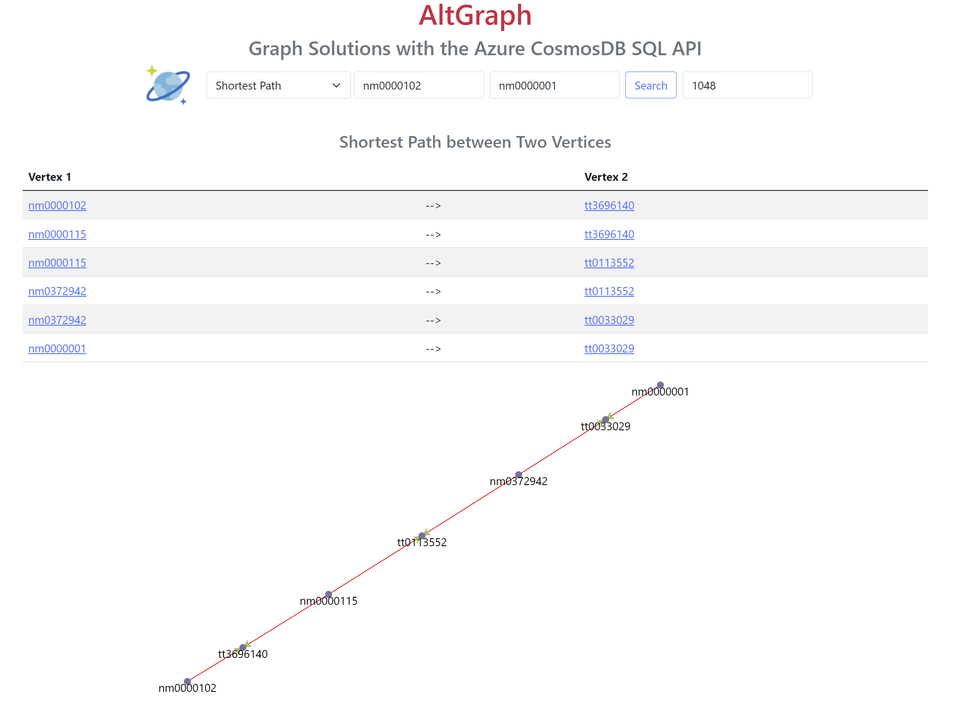
Demonstration – v2/IMDB: Shortest Path – Kevin Bacon to Fred Aistaire

Slide 38
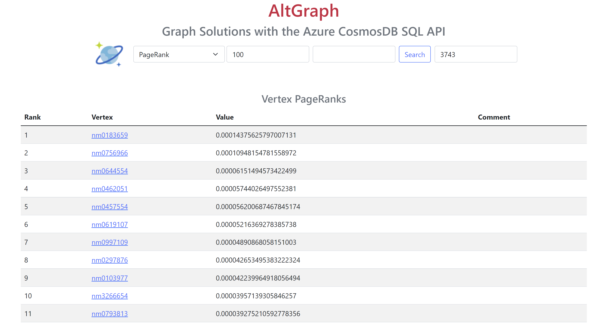
Demonstration – v2/IMDB: Page Rank Algorithm
Computes the Page Rank of all Vertices and lists the top 100. 3743 ms, 0 RUs.

Slide 39
Thank you!
Questions?

